Slide 1
Computer Interfacing CSE360
Md. Khalilur Rhaman
Associate Professor
CSE Department
BRAC University

Slide 2
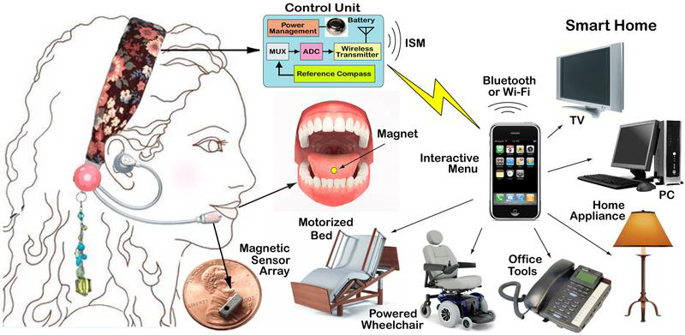
Interfacing Concept

Slide 3
Computing System Architecture
Computer
Main Memory
(RAM & ROM)
Peripheral
Devices
CPU
Peripheral
Devices
Interfacing
Interfacing
ALU
CU
Registers
Interfacing
Communication and Secondary Devices

Slide 4
Hardware Interfacing Architecture
Communication
Interfacing
Interfacing
Interfacing
High End Input
Interfacing
High End Processor Computer
Interfacing
High End Output
Sensor Input
Micro-Controller
Display, Sound or Motor Action
Calibration Circuit
Driver / Controller
Power

Slide 5
Catch me in
By email:
khalilur@bracu.ac.bd
khalilur@gmail.com
Whatsapp or SMS: 01752042223
Phone Call (in case of VERY argent): 01752042223
FACEBOOK, MESSENGER, SKYPE, VIBER etc. are restricted for students to communicate with me

